Slide 1
Week 4
THE relational algebra Binary operation of Union and Difference

Slide 2
Student Objectives
Upon completion of this video, you should be able to:
Decide if 2 tables are Union Compatible
Write a relational algebra expression that uses UNION given two tables and a query.
Given 2 tables and a UNION relational algebra expression, show the new table that would be returned once the expression is performed.
Write a relational algebra expression that uses DIFFERENCE given two tables and a query.
Given 2 tables and a DIFFERENCE relational algebra expression, show the new table that would be returned once the expression is performed.

Slide 3
Binary Operations
In arithmetic 8 ÷ 3 would be a binary operation because it has 2 operands: 8 and 3 and one operator: ÷
Most of the remaining relational algebra expression we are going to look at use binary operators (i.e. they require TWO tables)
For example: Table1 U Table2 would return a new table, our result.
Could also write: RESULTTABLE ← Table1 U Table2

Slide 4
Union Compatible
Two tables are union compatible, if and only if:
They have the same number of columns
Each respective column from each table is from the same domain
Examples → Are these Union Compatible?
TableA and TableB
TableA and TableC
TableB and TableD
NO
NO
YES
TableB
TableC
TableD
TableA
ID | Age
22 | 46
34 | 33
ID | Age | Name
22 | 46 | Bob
34 | 33 | Sam
X | Y
55 | 71
32 | 64
61 | 34
ID | Name | Age
22 | Bob | 46
34 | Sam | 33

Slide 5
UNION
Creates a new table from the given 2 tables that include every row from both tables with NO repeating identical rows.
The 2 Tables MUST be union compatible
Symbol → U
Example Expression:
Table1 U Table2
Table1
ID | FirstName | LastName | Age
12 | Homer | Smith | 24
24 | Gene | Simpson | 13
45 | Walter | Reid | 45
Table2
ID | FirstName | LastName | Age
33 | Marg | Jones | 28
24 | Gene | Simpson | 13
ANSWER
ID | FirstName | LastName | Age
12 | Homer | Smith | 24
24 | Gene | Simpson | 13
45 | Walter | Reid | 45
33 | Marg | Jones | 28
First Table Name
Symbol for Union
Second Table Name

Slide 6
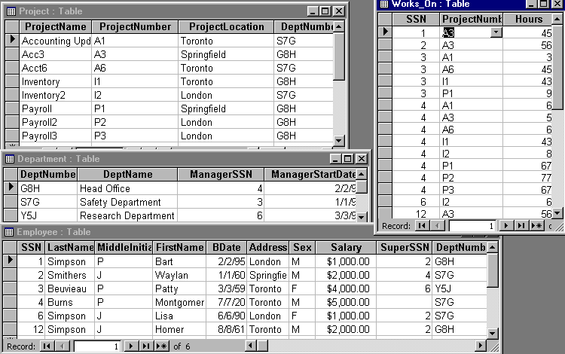
Temp1 _{(SuperSSN)} ← π _{ManagerSSN} (Department)
Result ← Temp1 U π _{SuperSSN}(Employee)
Temp1
SuperSSN
4
3
6
Result
SuperSSN
4
3
6
2

Slide 7
QUESTION: What would the following relational expression result in?
Temp1(Field1) ← π MiddleInitial (Employee)
Temp2(Field1) ← π Sex (Employee)
Result ← Temp1 U Temp2
Temp1
Temp2
Result
Field1
P
J
Field1
F
M
Field1
P
J
F
M

Slide 8
QUESTION: What would the following relational expression result in?
Temp1(Loc) ← πProjectLocation (Project)
Temp2(Loc) ← πAddress (σ LastName = “Simpson” (Employee))
Result ← Temp1 U Temp2
Temp1
Temp2
Result
Loc
Toronto
Springfield
London
Loc
London
Toronto
Loc
Toronto
Springfield
London
QUESTION: What, in English, does the above expression represent?
Show me all the project locations cities together with the cities that the Simpson employee’s live in.

Slide 9
Write a relational algebra expression that would need to use Union
Write the Relation Algebra expression to answer this query: Return the first name of all students and faculty at Western whose name starts with D
Faculty
Student
ID | FirstName | LastName | Office Number
12 | Dave | Smith | MC316
24 | Walter | Simpson | MC416
45 | Donald | Reid | SSC22
StudentID | FName | LName | HomeCity | Major
2501 | Daisy | Jones | Windso | Math
2509 | Walter | Simpson | Arva | CS
2508 | Donald | Cook | Milton | Math
2588 | Wally | Webster | Milton | CS
Temp1_{(FName)} ← _{π FirstName} (_{σFirstName like “D*”}(Faculty))
Temp2 ← _{π FName}(_{σFName like “D*”}(Student))
ANSWER ← Temp1 U Temp2

Slide 10
DIFFERENCE
Create a new table from the given 2 tables that include every row from the table on the left side that is NOT in the table on the right side.
The 2 Tables MUST be union compatible
Symbol → –
Example Expression:
Table1 – Table2
Table1
ID | FirstName | LastName | Age
12 | Homer | Smith | 24
24 | Gene | Simpson | 13
45 | Walter | Reid | 45
Table2
ID | FirstName | LastName | Age
33 | Marg | Jones | 28
24 | Gene | Simpson | 13
ANSWER
ID | FirstName | LastName | Age
12 | Homer | Smith | 24
45 | Walter | Reid | 45
First Table Name
Symbol for Difference
Second Table Name

Slide 11
More ON DIFFERENCE
NOTE that Table1 – Table2 does NOT equal Table2 – Table1
e.g Answer ← Table2 – Table1
Table1
ID | FirstName | LastName | Age
12 | Homer | Smith | 24
24 | Gene | Simpson | 13
45 | Walter | Reid | 45
Table2
ID | FirstName | LastName | Age
33 | Marg | Jones | 28
24 | Gene | Simpson | 13
ANSWER
ID | FirstName | LastName | Age
33 | Marg | Jones | 28

Slide 12
RESULT ← π_{LastName}(Employee) – π_{LastName}(σ_{Sex=“M”}(Employee))
RESULT
LastName
Beuvieau

Slide 13
QUESTION: What would the following relational expressions result in?
Temp1 (SSN) ← π ManagerSSN (Department)
Temp2 (SSN) ← π SuperSSN (σ_{SuperSSN} _{<>Null}(Employee))
Result1 ← Temp1 – Temp2
Result2 ← Temp2 – Temp1
Temp1
Temp2
Result1
Result2
SSN
4
3
6
SSN
2
4
6
SSN
3
SSN
2
QUESTION: What do they mean in English?
Result1 means: Show me all the employee ids for people who are departmental managers but not also supervisors.
Result2 means: Show me all the ids for people who are employee supervisors but not also departmental managers.

Slide 14
Write a relational algebra expression that would need to use DIFFERENCE
Write the Relation Algebra expression to answer this query: Return the first name of all faculty members who don’t have the same first name as any of our students.
Faculty
Student
ID | FirstName | LastName | Office Number
12 | Dave | Smith | MC316
24 | Walter | Simpson | MC416
45 | Donald | Reid | SSC22
StudentID | FName | LName | HomeCity | Major
2501 | Daisy | Jones | Windso | Math
2509 | Walter | Simpson | Arva | CS
2508 | Donald | Cook | Milton | Math
2588 | Wally | Webster | Milton | CS
Temp1_{(FName)} ← _{π FirstName} (Faculty)
Temp2 ← _{π FName}(Student)
ANSWER ← Temp1 – Temp2

